Slide 1
Network Builder
CS-211 Final By Peter Boster

Slide 2
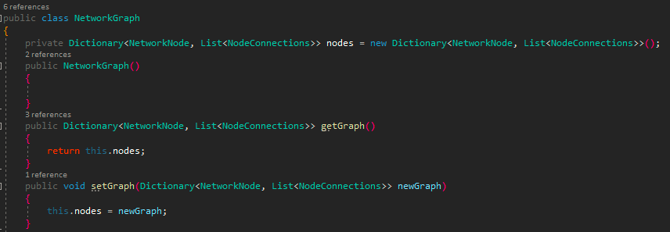
Coolest Parts of My Program
The code I am most proud of would definitely be my NetworkGraph class.
Proud of it because of how it incorporated all of other classes and functionalities and because it essentially represents a building, which I think is cool.

Slide 3
The Code I am Proudest Of
Everything! The whole project pushed my mentally, and it was extremely satisfying to watch all of the classes work together and to see them working.

Slide 4
If I could do it all over again, I would…
Start earlier
Draw out my design before starting
It was hard to conceptualize how the code would be structured, so this would have saved me a lot of time.
Not let things in my personal life get in the way of this project
Extremely hard sometimes, but is very important

Slide 5
The thing that I learned the most was…
The thing that I learned the most from this project had nothing to do with coding, but with managing my personal life and school. The thing I learned was that even when life sucks and I don’t feel motivation to do anything, I shouldn’t let that negativity drag into my schoolwork.
For the last month or two, as I think we all did, I had a really rough time in my personal life. At first, I let it get in the way of my schoolwork, and I started shut off and started to give up. Because of this, I started my projects for all my classes a little late, but once I started this one, it became a way for me to “escape” everything that was going on, and allowed me to get in a better place where I wasn’t sacrificing my future and my progress in this class over a rough week.

